Slide 1
Contents
Purpose
Background
Data Exploration
Data Transformation
Migration to PySpark
Data Pipeline
Test Suite
Dashboard

Slide 2
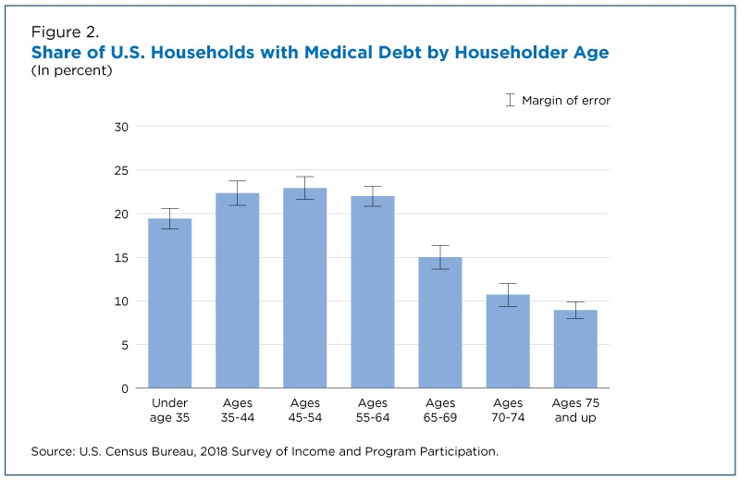
Purpose
“Medical debt is now the No. 1 source of debt collections, surpassing debt in collections from credit cards, utilities, auto loans, and other sources of combined.” - Stanford Institute for Economic Policy Research
Patients have no idea what they will be charged until AFTER their procedure
19% of U.S. households carried medical debt

Slide 3
Background
Hospital Price Transparency back in January 2021
Most hospitals are non-compliant
There should be an easier way for patients to check the price of their procedure

Slide 4

Breakdown of healthcare charges

Slide 5
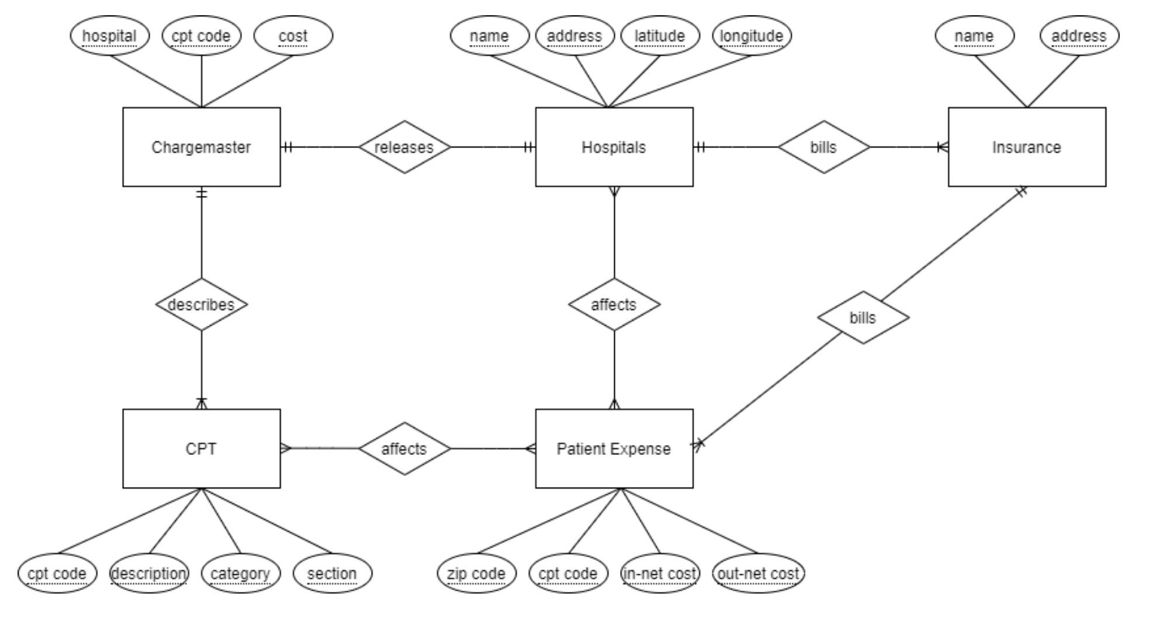
Overview
1
2
3
4
5

Slide 6





Data Exploration

Slide 7
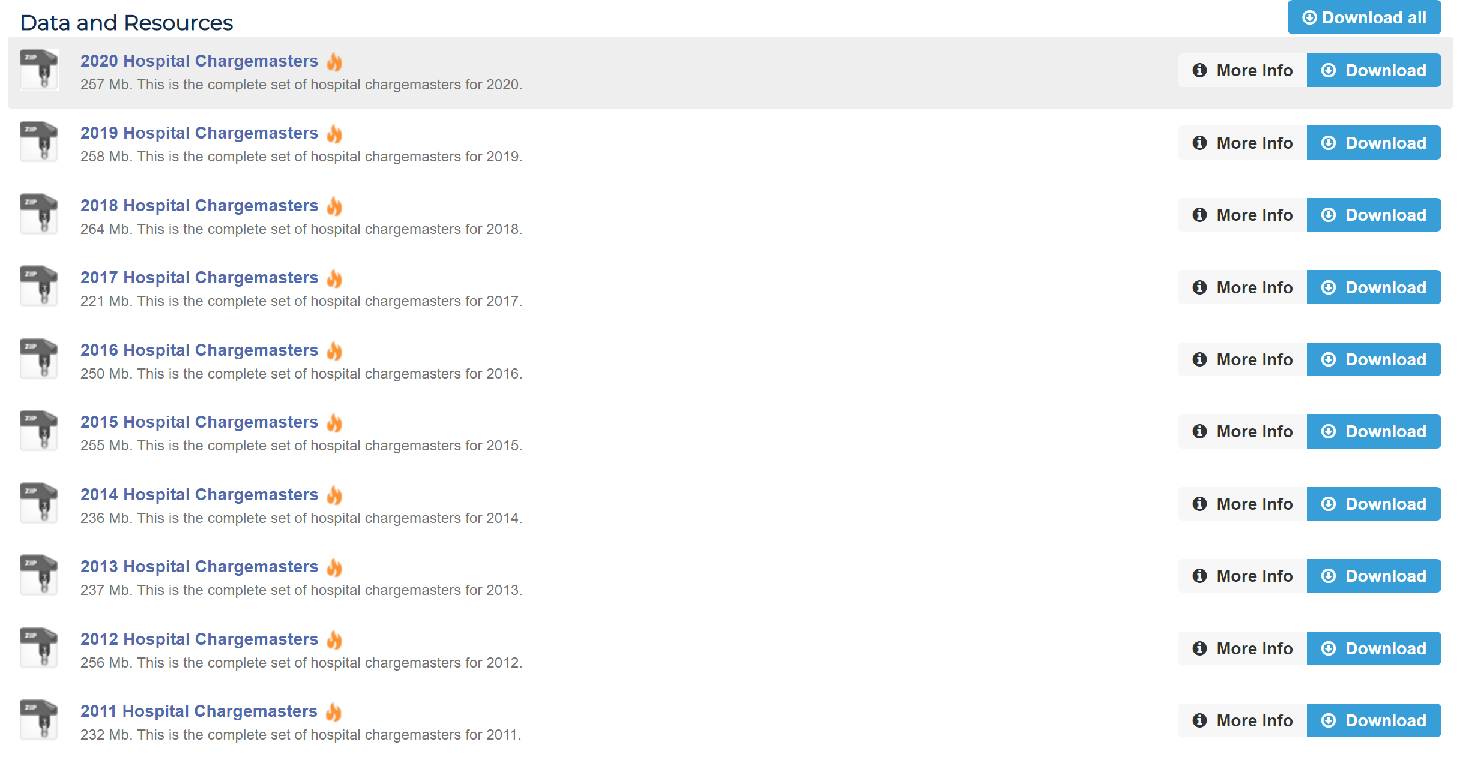
1. Charge Master Dataset
1.1 Downloaded from https://data.chhs.ca.gov/dataset/chargemasters

Slide 8
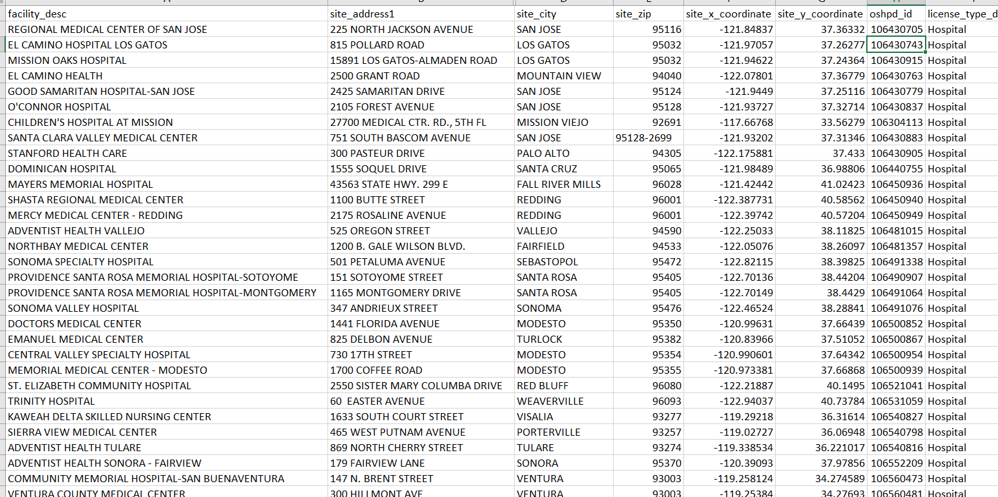
2. Hospital Profile Dataset
Downloaded from https://data.chhs.ca.gov/dataset/facility-profile-attributes

Slide 9
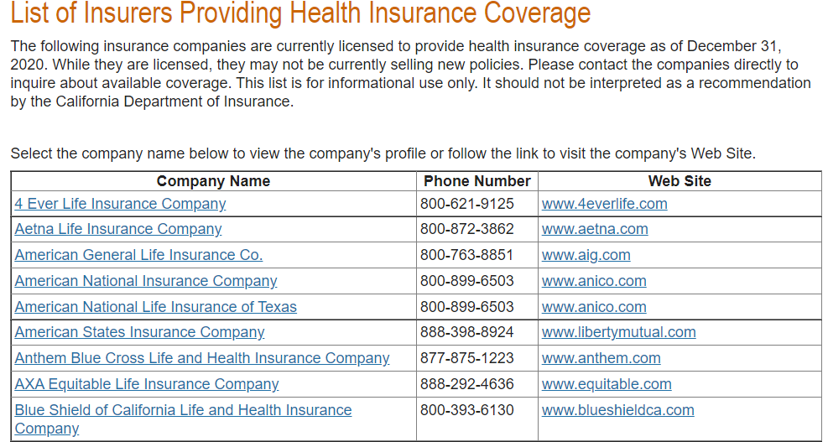
3. Insurance Dataset
Table copied from http://www.insurance.ca.gov/01-consumers/110-health/20-look/hcpcarriers.cfm

Slide 10
4. CPT Dataset
1.1 Downloaded from https://www.cms.gov/Medicare/Medicare-Fee-for-Service-Payment/PhysicianFeeSched/PFS-Relative-Value-Files
1.2 HCPCS vs CPT codes
https://www.medicalbillingandcoding.org/hcpcs-codes/
“Level one is identical to CPT, though technically those codes, when used to bill Medicare or Medicaid, are HCPCS codes”
1.3 Which file to use:
Updated every quarter, use part D (last quarter of year)
Use RVU files (Relative Value Units) in text format

Slide 11
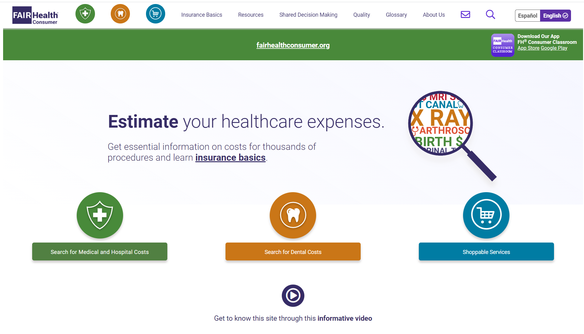
5. Patient Expenses Dataset
1.1 Scraped from https://www.fairhealthconsumer.org/

Slide 12
Data Transformation

Slide 13
1. Charge Master Dataset
1.2 Cleaning raw charge masters
Problem:
CA government only required excel files (no uniform format).
Each hospital submitted data under different excel files, sheet names, table formats, etc.
Makes it hard to find the target ‘Common OP Procedures’ table.
Solution:
Script to extract all target sheets (next slide)
Look through each sheet in every excel file in each hospital folder
Check if known header of target form exist in the sheet
Track excel file path and sheet name that meets criteria.

Slide 14
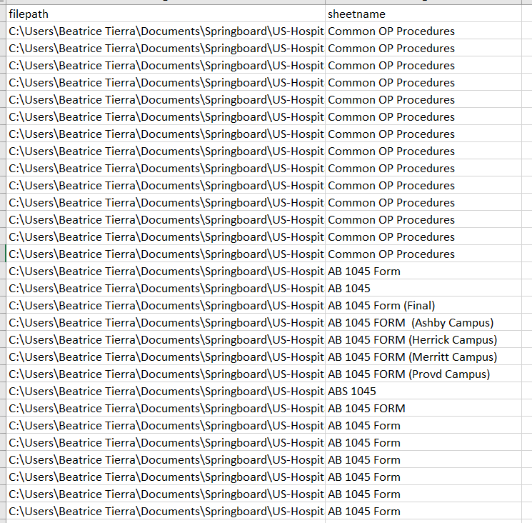
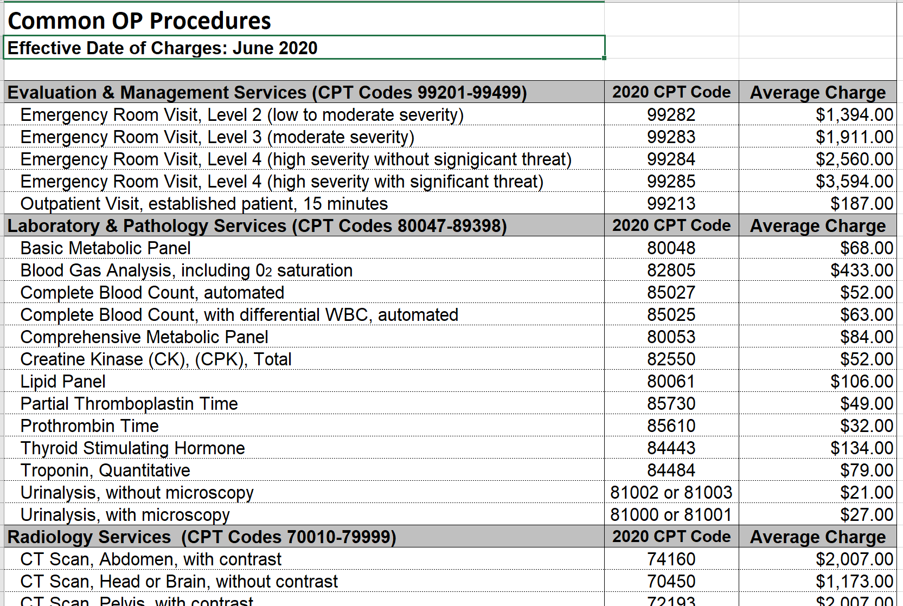
1. Charge Master Dataset
1.2 Cleaning raw charge masters (cont.)
Each hospital’s form (raw data)
Found filename and sheet name of target forms

Slide 15
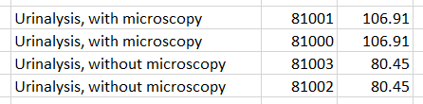
1. Charge Master Dataset
1.2 Cleaning raw charge masters (cont.)
After finding all target form locations:
Read each sheet
Extract only rows with valid CPT code
Clean CPT codes
Combine all data frames to include all hospitals.
Final table columns: Hospital, Description, CPT Code, Cost

Slide 16
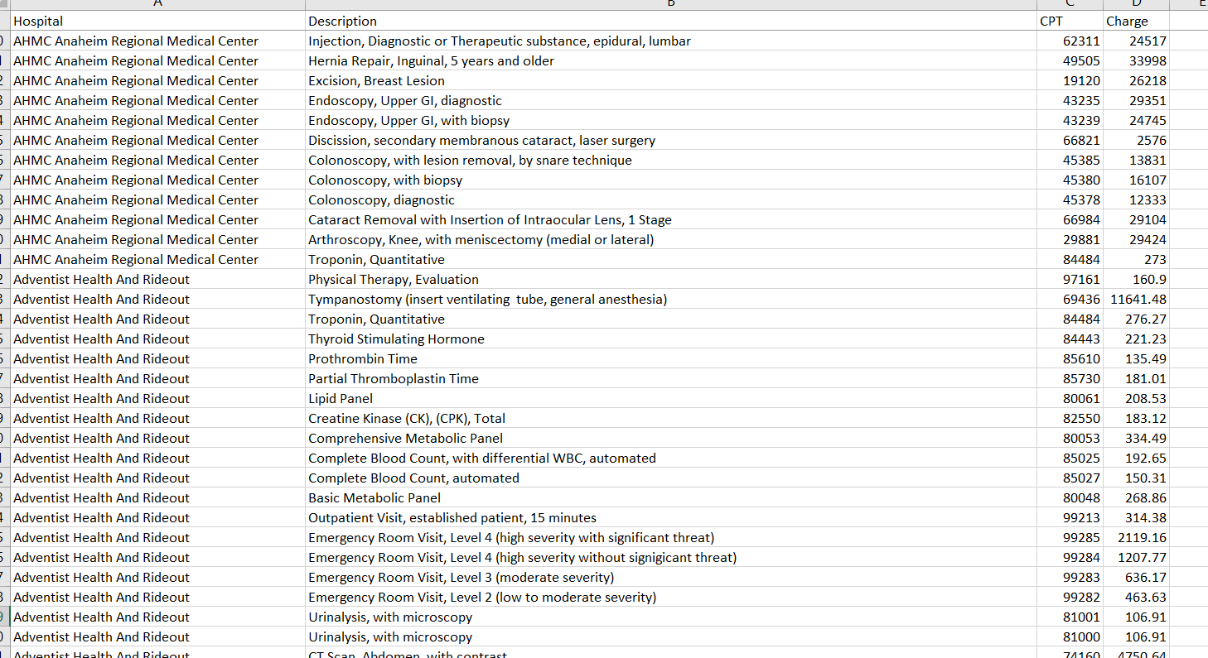
1. Charge Master Dataset
1.3 Final charge masters dataset

Slide 17
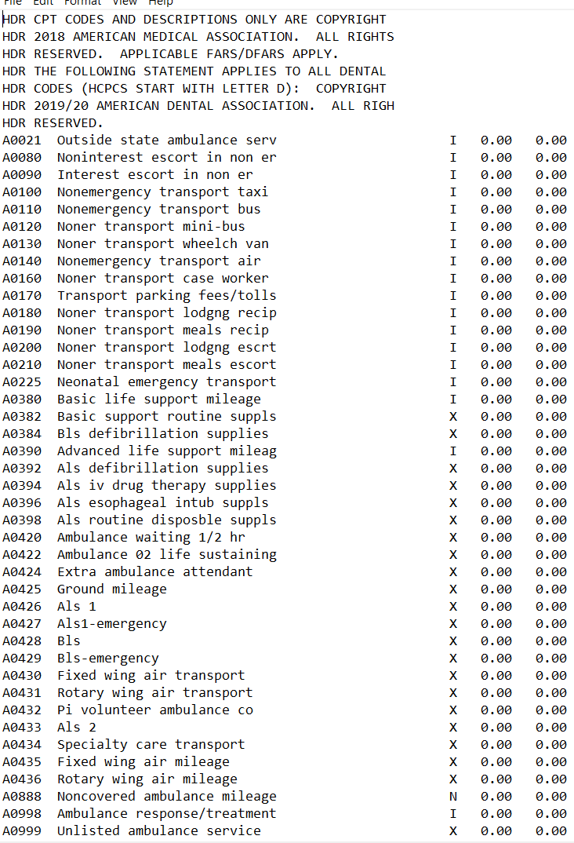
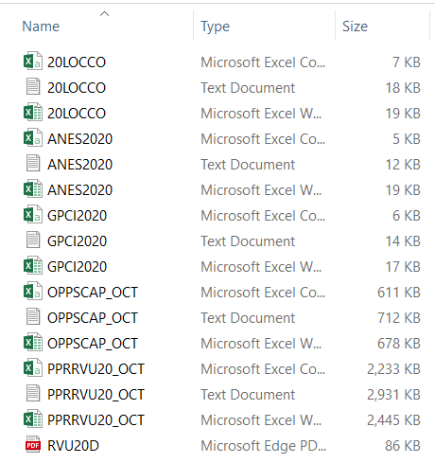
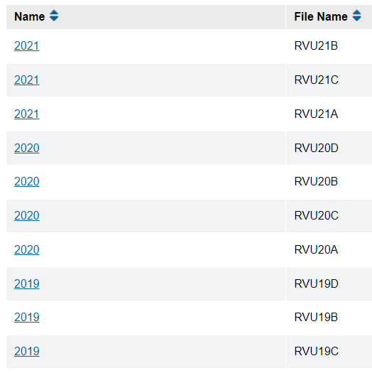
4. CPT Dataset
1.3 Which file to use (cont):
Ex. Get CPT codes for 2020

Slide 18
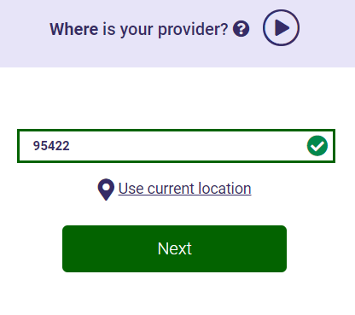
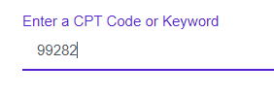
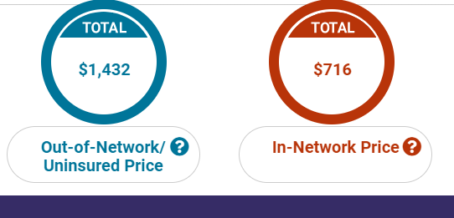
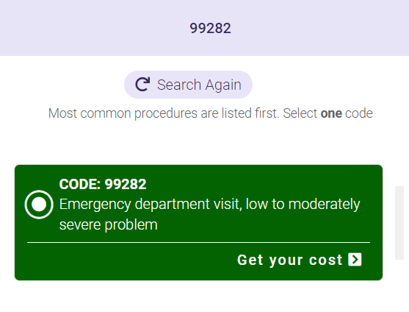
5. Patient Expenses Dateset
1.2 Process
Use Selenium to enter CPT and zip code to find the cost of a certain procedure in an area
Use BeautifulSoup to extract the in-network and out-of-network (hospital accepts insurance or not) cost
Enter Zip Code
Enter CPT Code
Get Out-of-Network vs In-Network Price

Slide 19
Migration to PySpark

Slide 20
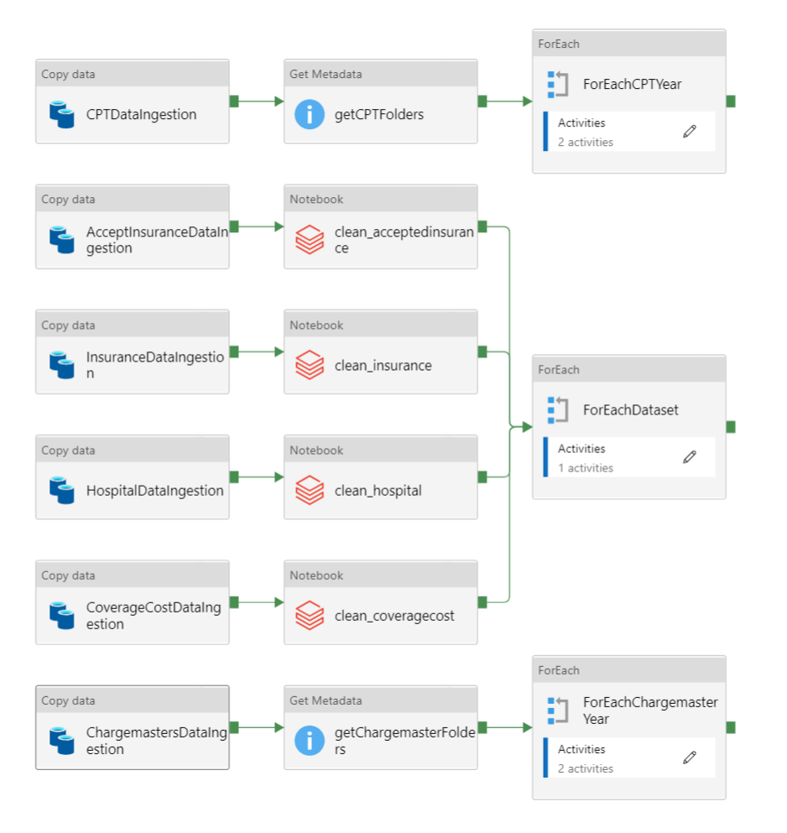
Data Pipeline
1
Each highlighted box runs separately but in parallel in the same pipeline.
Each separate data flow :
Ingests raw data from local drive
Copies data to Azure Blob Storage
Processes and cleans data into dataframes
Exports dataframes as parquet files in the same Blob Storage
Creates tables from each dataframe in Azure SQL Database
2
3

Slide 21
Migration to PySpark

Slide 22
Citations
K. Crawford, “America's medical debt is much worse than we think,” SIEPR. [Online]. Available: https://siepr.stanford.edu/news/americas-medical-debt-much-worse-we-think. [Accessed: 01-Sep-2021]

